Slide 1
EIS health & well-being event: supporting the social and emotional well-being of teachers and lecturers
Keynote: larry Flanagan EIS general secretary
Susan mcavoy eis learning rep

Slide 2

welcome

Slide 3
Why we are here today…
We are here today, because we all are interested in our health, our well-being (our sanity) and learning more about how we can support ourselves and our colleagues, To be the best teachers & lecturers we can be.
A wee story…

Slide 4
Mental health landscape
The proportion of 15 to 16 year olds reporting that they frequently feel anxious or depressed has doubled in the last 30 years
from 1 in 30 to 2 in 30 for boys
1 in 10 to 2 in ten for girls (Young Minds, 2016).

Slide 5

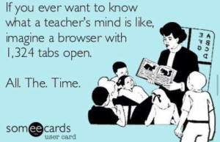
But today is about us…

Slide 6
But today is about us…
All UK teacher unions are finding that teachers are leaving or considering leaving the profession due to stress and workload. And all are reporting high levels of occupational stress, anxiety & depression.
How can we support ourselves, our learners & our colleagues when we feel so under pressure?
There is evidence that developing our social and emotional skills or competencies are protective against bad stress and ‘burnout cascade’ (Jennings and Greenberg, 2009).

Slide 7
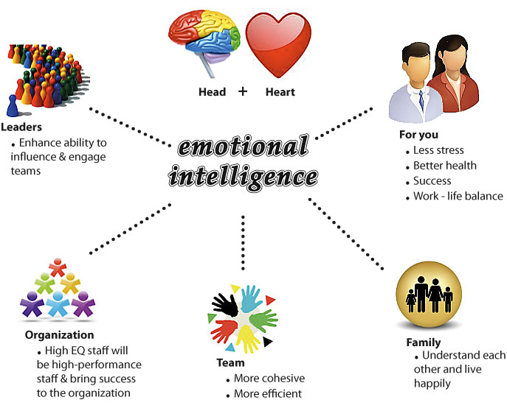
Social and Emotional Learning (SEL)

Slide 8
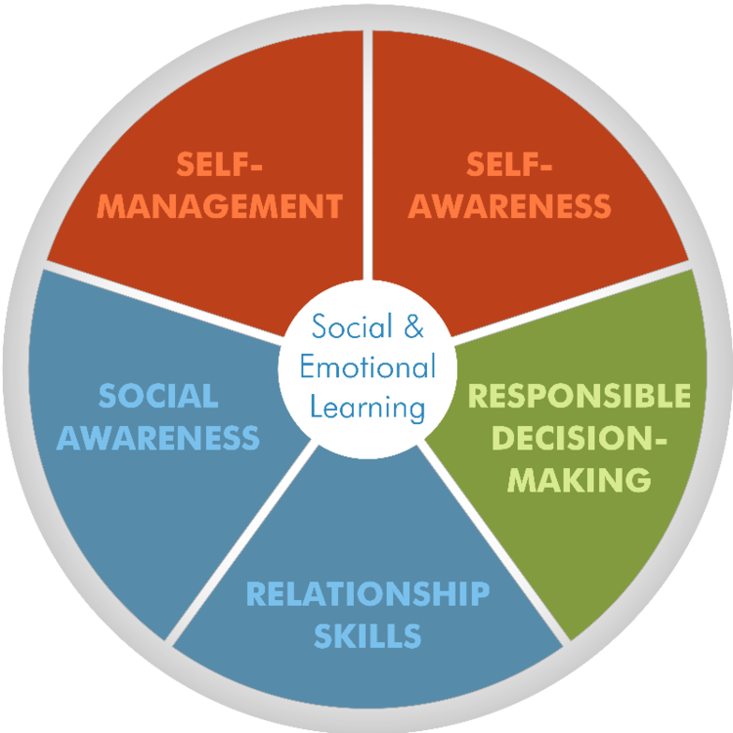

Social and emotional skills/competencies
Developing our social & emotional skills can help us become less stressed and more balanced.

Slide 9

Let’s have a moment to reflect…
Listen until the sound of the tone disappears.
Then tune in to just the sense of sound
and focus all your attention on listening.
We’ll do that for a minute or two……

Slide 10
Let’s have a moment to reflect…
Then think of a recent situation that was emotionally charged for you
•How did you feel during this situation? Name the specific emotions that you felt.
•What were your emotions telling you? Emotions are providing information about ourselves. Exploring the meaning of our emotions is an important step toward developing self-awareness.
•What did you do about these feelings? We often hide, ignore or deny uncomfortable feelings, such as shame, fear, and anger. But ignoring these emotions won't make them go away. Taking time to name our feelings and explore their meaning will help us make better decisions.
•Based on these reflections, what would you do differently the next time you're faced with a similar situation?

Slide 11
Strategies & the way forward
The research evidence strongly suggests that ‘a lack of social and emotional competence constitutes a risk factor for teachers’ well-being, its presence operates as a protective factor, leading to effective coping and resilience in the face of stress’ (cevai C., cavioni V. 2014).
These authors also recommend regular and specific professional development to develop these skills.
The founders of Casel recommend mindfulness training for teachers as its effects on attention, emotion & behaviour mean that the 5 competencies are naturally achieved.

Slide 12
Today is a beginning
So those of you attending Rachel’s workshop on resilience will have an opportunity to experience some mindfulness practice & learn how to strengthen your resilience muscles.
Those of attending lee’s session will be able to experience being more mindful of your bodily movements and patterns, enhancing your self-awareness & your physical muscles.

Slide 13
Today is a beginning
Maggie’s workshop will allow you to become self aware as you identify your strengths and will allow you to more successfully build relationships with those around you, while working with your cognitive muscles.
Susan’s session is all about mindfulness with practices, a bit of science and examining how this daily practice can enhance our social and emotional competency, by strengthening our attentional muscles. ☺

Slide 14
Sources & resources
Cefai c., cavioni v. (2014) social and emotional education in primary school: integrating theory and practice, new York, springer
Casel collaborative for academic, social and emotional learning
http://www.casel.org/social-and-emotional-learning/
Edutopia: Developing Teachers Social and emotional skills
http://www.edutopia.org/blog/developing-teachers-social-emotional-skills-lorea-martinez
The six seconds eq model
http://www.6seconds.org/2010/01/27/the-six-seconds-eq-model/

